Slide 1
Intern at Spark Foundation
Data Science and Business Analytics
Task – 1 - Prediction Using Supervised ML(Linear Regression)
Presented By – Abhijeet Rajwade

Slide 2
Prediction Using Supervised ML
Machine learning – Using Linear Regression
Language – Python
Libraries Used - Pandas, NumPy, Sklearn, Matplotlib, Seaborn

Slide 3

Prediction Using Supervised ML
Linear regression -- It is a statistical method that is used for predictive analysis. Linear regression makes predictions for continuous/real or numeric variables such as sales, salary, age, product price, etc.
Basic Fundamental behind Linear Regression Two Variable
Y = Mx +C
Constant
Dependent Variable
Independent Variable

Slide 4

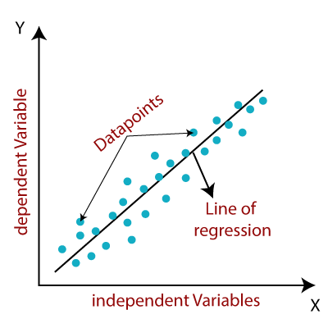

PREDICTION USING SUPERVISED ML
Linear Regression of Two Variable using Graph

Slide 5
Prediction Using Supervised ML
Steps Involved :-
Importing Libraries
Loading data from provided remote url
Exploring Data
Type of data
Train Test Split
Training the Simple Linear Regression Model on Training Set
Visualization
Visualizing Test Set Result
Predicting Test Result
Predicting no. of hour = 9.25
Evaluate the performance of algorithm.

Slide 6
PREDICTION USING SUPERVISED ML
Let see the coding in Jupiter Notebook for Linear Regression

Slide 7
Thank You...
Please Post in comment section for any Queries and Suggestions.....

